Slide 1
Governance Risk and Compliance (GRC)

Slide 2
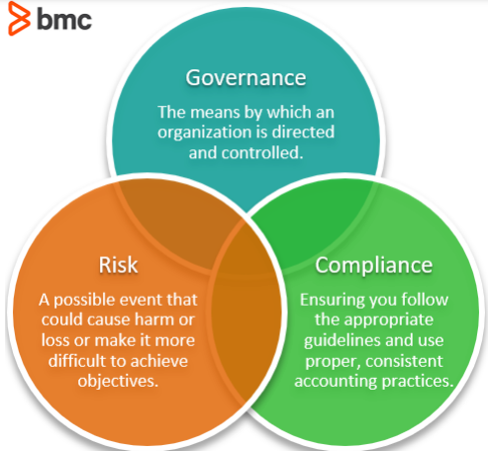

Governance Risk and Compliance(GRC)
Strategic framework that organization implement to manage and automate governance, risk management and compliance management.
Responds to business risk in the real time. Connect Security and IT with integrated risk program offering continuous monitoring, prioritization and automation.
Organizational Pain Points prior Implementing GRC
Uncertain decision-making
No Collaboration
Operational Efficiency
Change Management
Data Quality
Manual Process

Slide 3
Why ServiceNow GRC
Reduce costs through automation, compliance violations, and breaches.
Reduce risk posed by vendors.
Improve ability to adapt to changes in business models, risks associated with digital transformation, or new regulations.
Greater ability to gather quality information quickly and efficiently from employees and vendors.
Increase access to risk Information across the enterprise with a single repository.
Greater ability to repeat processes in a consistent manner.
Improve productivity by eliminating repetitive and redundant tasks.
Effective communication with stakeholders across the business, with executive, and to the board.
Real-time risk data and the ability to calculate the impact to the business.

Slide 4
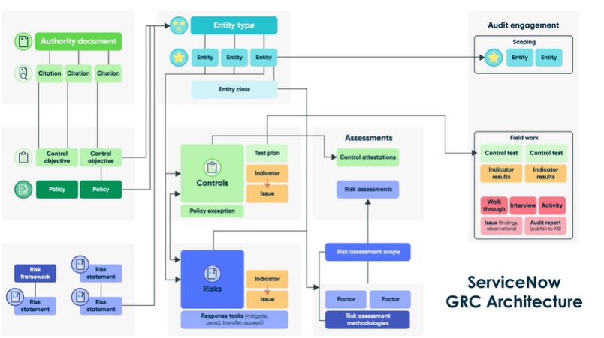

GRC Architecture
Governance, Risk, and Compliance
Risk Management
Audit Management
Vendor Risk Management
Policy and Compliance Management

Slide 5
Integrated Risk Management(IRM)
Integrated Risk Management (IRM) provides organization with an end-to-end integrated enterprise toolset, to improve risk visibility and align risk and compliance efforts to business priorities and objectives.
IRM ServiceNow, uses the ServiceNow Governance, Risk, and Compliance (GRC) suite of applications.
With GRC, organizations embed risk management, compliance activities, and intelligent automation to continuously monitor and prioritize risk.
ServiceNow IRM supports standard functionality and workflows for managing all organizational risk domains. E.g. Reputational, Strategic, Operational, Compliance and Financial Risk
Risks Types -
Operational
Risk
Reputational
Risk
Compliance
Risk
Strategic
Risk

Slide 6
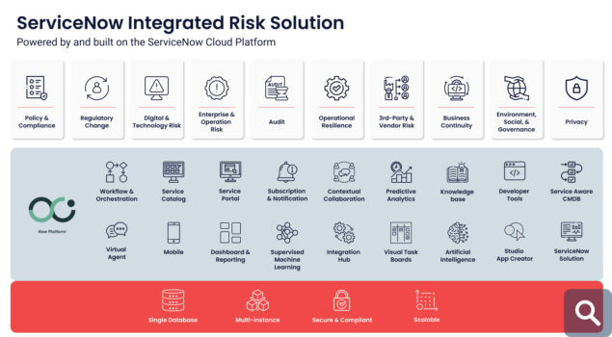
Risk management architecture​

